Slide 1
Excel Internal Assessment
4379
NITHIKKSHA

Slide 2
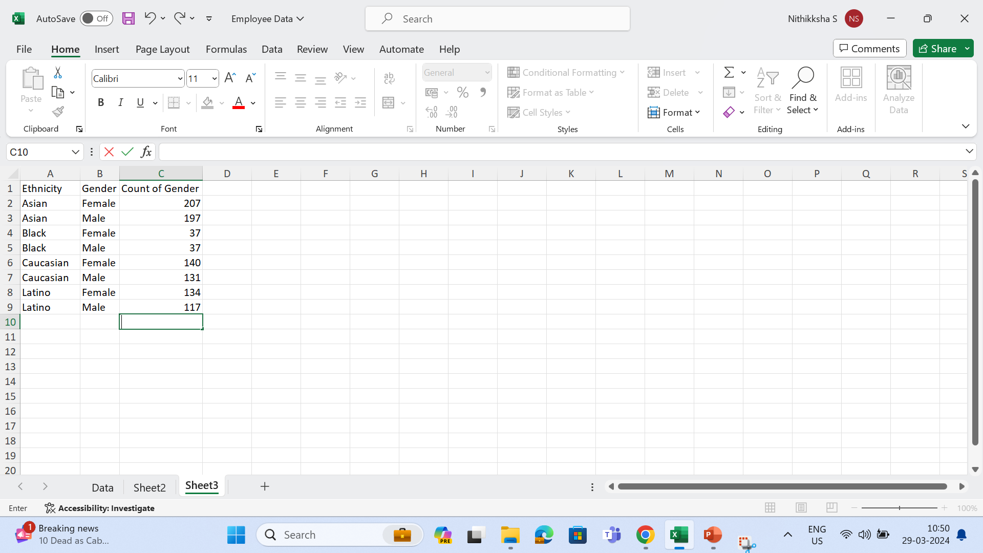
1.Summary of gender and ethnicity distribution

Slide 3
INFERENCE
To find gender and ethnicity column, I’ve used pivot table
In the summary, Asians works higher in both malke and female followed by caucasian

Slide 4
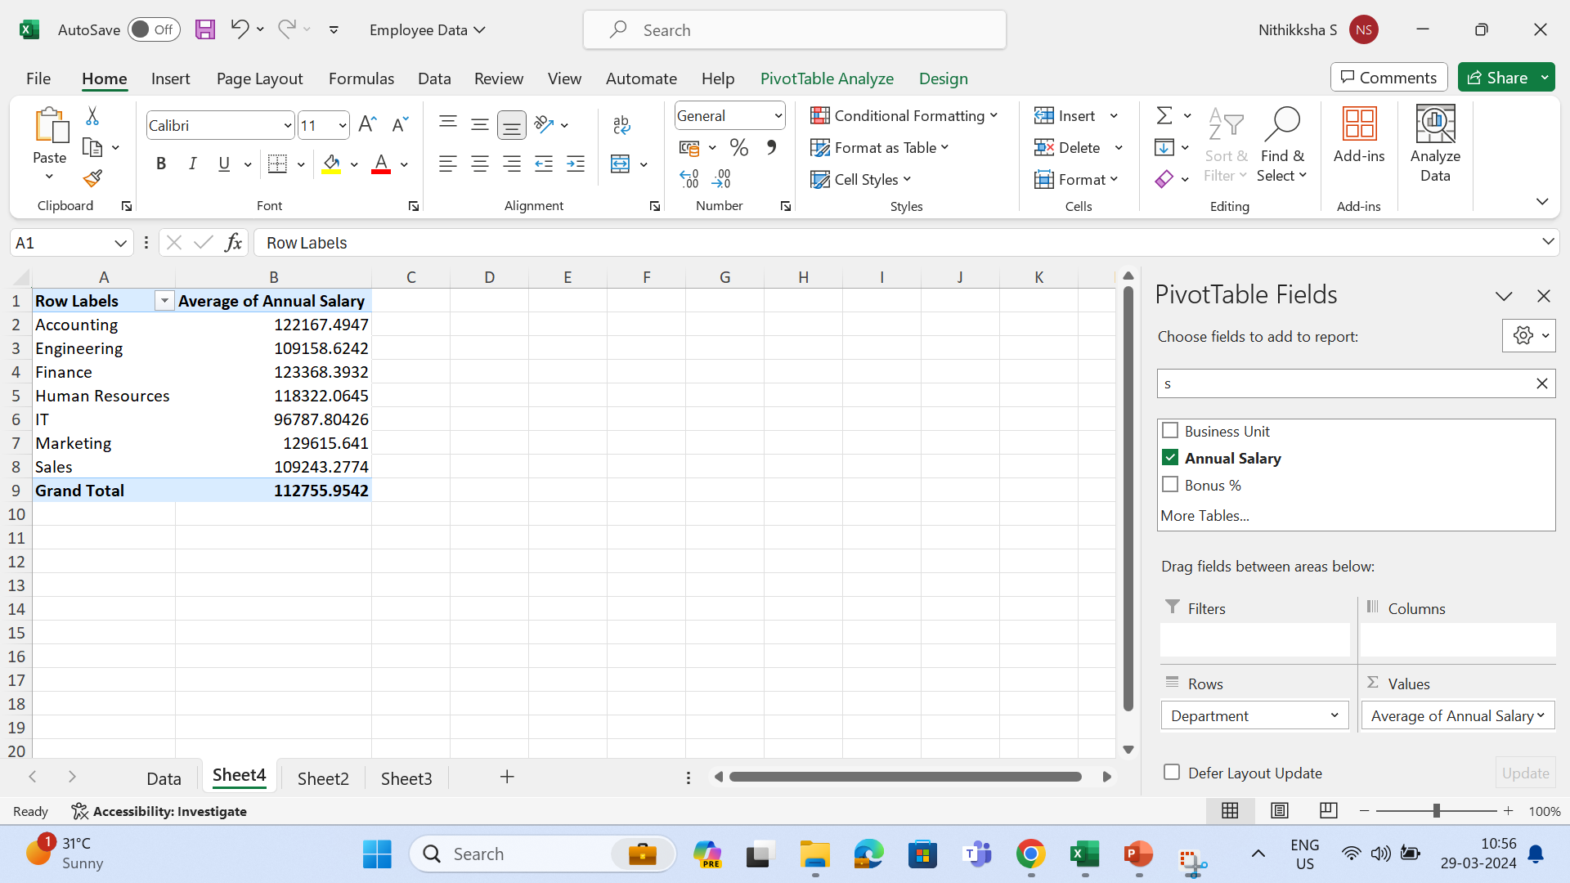
3.Significant difference between salaries in department

Slide 5
inference
IT team marks the highest salary while marketing team gets the lowest salary
here’s no huge significance difference between salaries between other departments

Slide 6
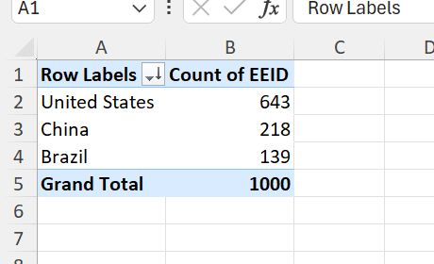
4. The country that has highest number of employees

Slide 7
inference
United states has highest number of employees followed by china and brazil

Slide 8
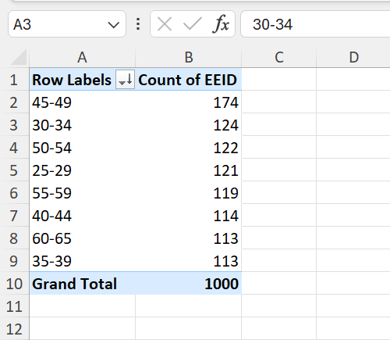
5. Most common age range

Slide 9
inference
The most common age range between employees are 35-44

Slide 10
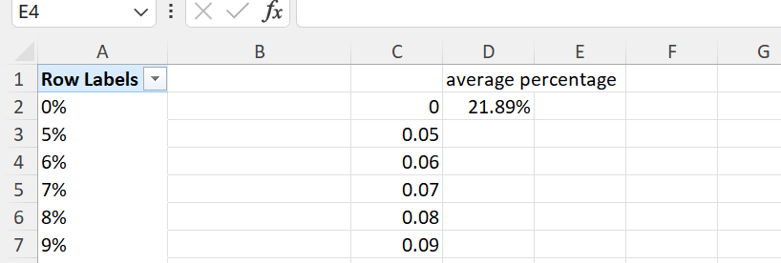
6.Average bonus percentage

Slide 11
The average bonus percentage of employees are 21.89%

Slide 12
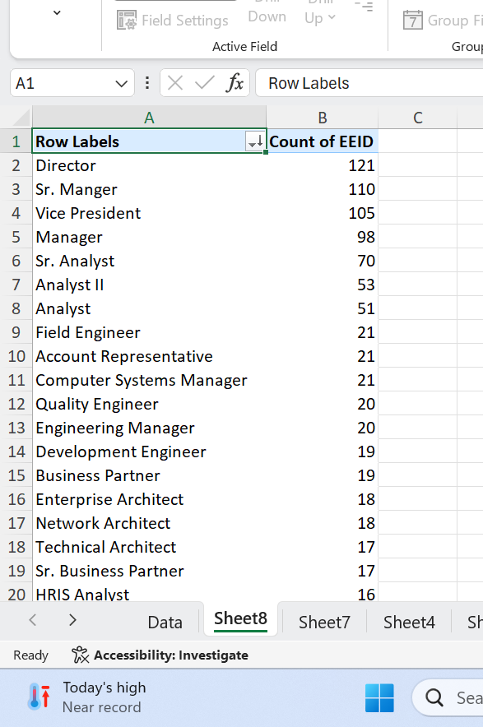
7.Job title that occurs frequently

Slide 13
Director, sr manager and vice president occurs frequently in this dataset

Slide 14
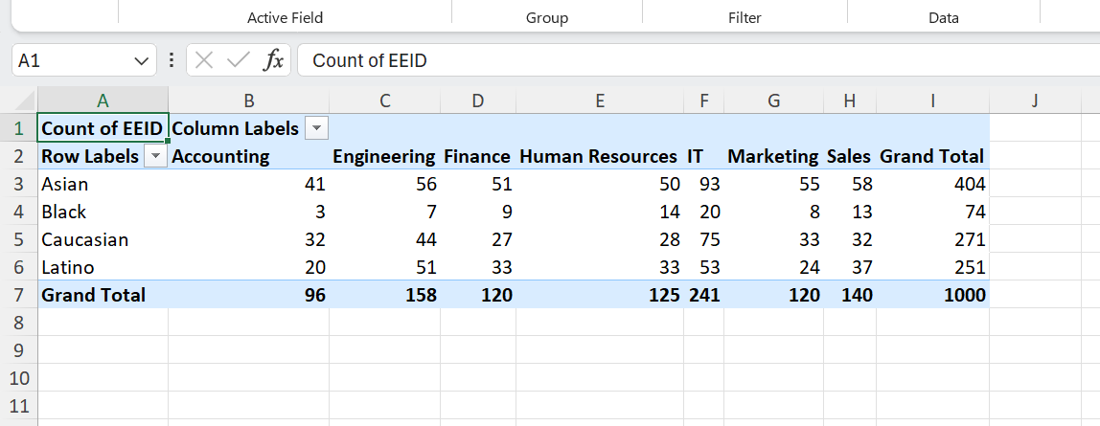
9.Certain departments more diverse in ethnicity

Slide 15
IT , engineering are more diverse in ethnicity

Slide 16
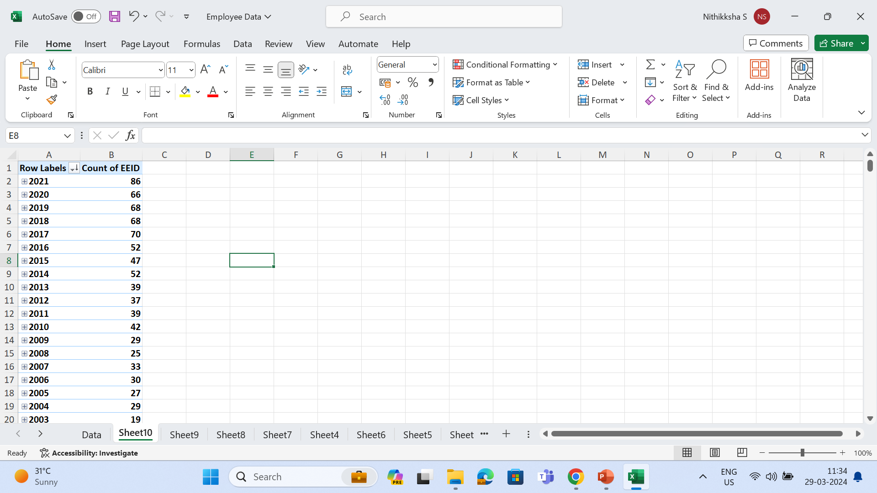
10.Increase in decrease in number of hires

Slide 17
In 2021, the number of hires is high, rest there’s no significant increase

Slide 18
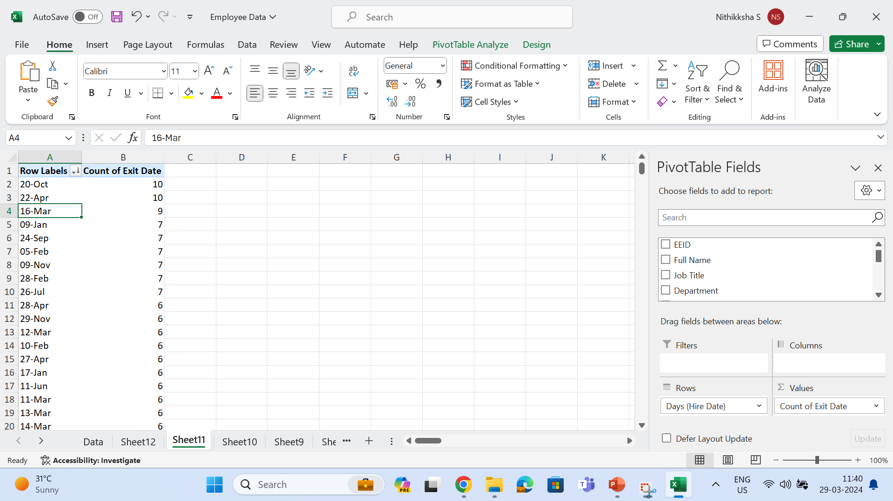
2. How long employee stayed

Slide 19
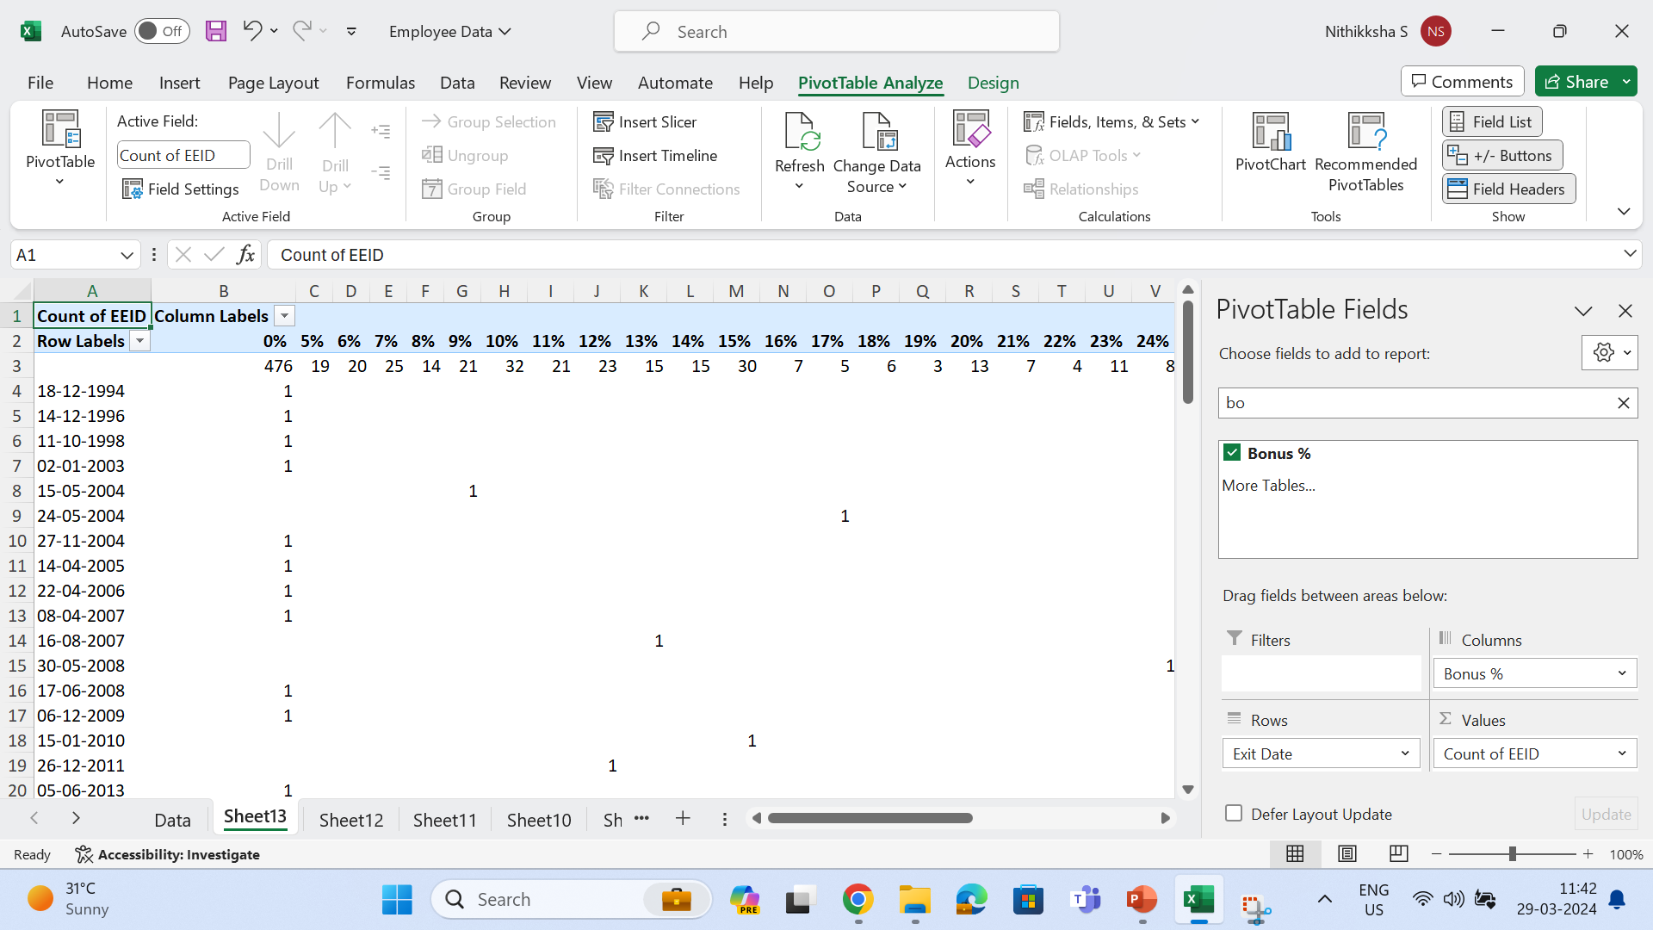
8.Reasons for employee exit

Slide 20
The main reason for employee exit is less in bonus while looking into the datasets.

